Slide 1
Time Series: Autoregressive models ARIMA-Part1
1 / 77

Slide 2
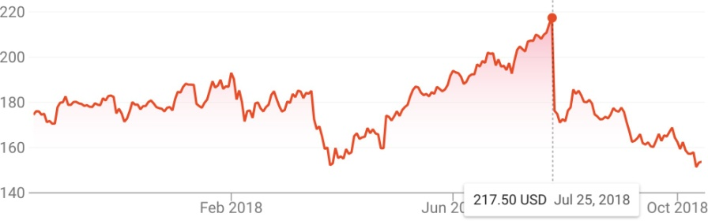
Time Series
A time series is a sequential set of data points, measured typically over successive times.
Time series analysis comprises methods for analyzing time series data in order to extract meaningful statistics and other characteristics of the data.
2 / 77

Slide 3
Autocorrelation and ARIMA Models

Slide 4
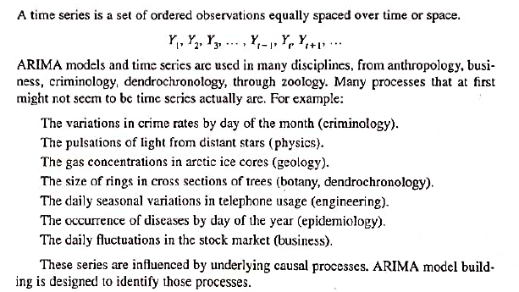

Slide 5
Time Series Analysis
Focus on stochastic process.
assume a time series can be defined as a collection of random variables indexed according to the order they are obtained in time, Y₁, Y₂, Y₃, . . . Y_{t}
t will typically be discrete and vary over the integers t = 0, ±1, ±2, . . .
Note
the collection of random variables {Y_{t} } is referred to as a stochastic process, while
the observed values are referred to as a realization of the stochastic process (next slide).
5 / 77

Slide 6
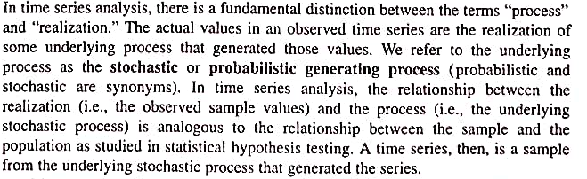
Process Vs Realization

Slide 7
Purpose of TS Analysis is:
Using the realization of a process
Identify a Model of the ARIMA process

Slide 8
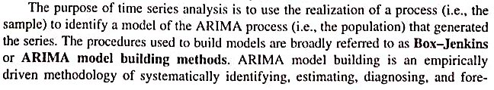
Purpose of TS Analysis
casting.

Slide 9
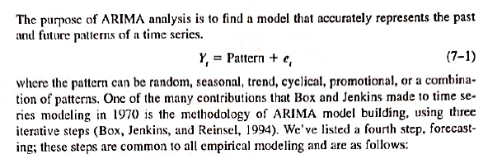
ARIMA ANALYSIS

Slide 10
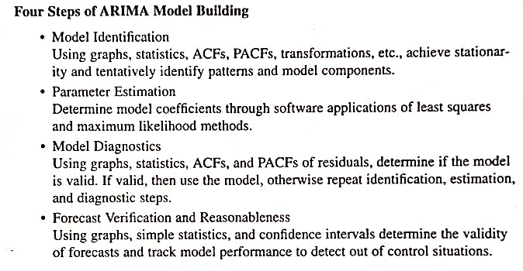

Slide 11
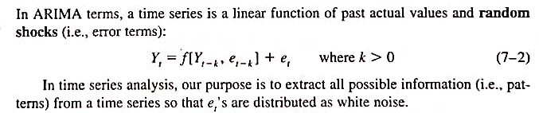
ARIMA ANALYSIS

Slide 12
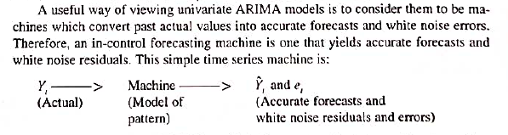
ARIMA ANALYSIS

Slide 13
OBJECTIVE-ARIMA?
Design the right machine empirically
NB: The forecasting model is not chosen a-priori

Slide 14
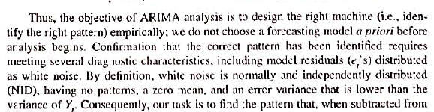
OBJECTIVE- ARIMA

Slide 15
Autocorrelation Functions (ACF)

Slide 16
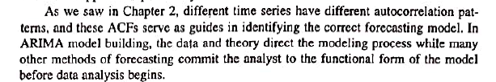
ACF
ARIMA models are built empirically using the 4 steps stated earlier.
There is no general model of ARIMA, instead, a model is chosen out of empirical evidence and theory.

Slide 17
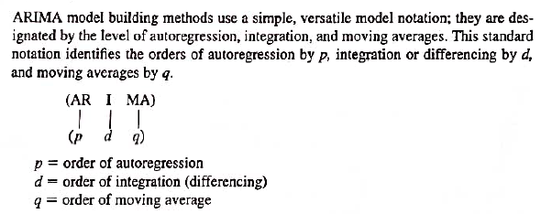
ARIMA Notation – p,d,q

Slide 18
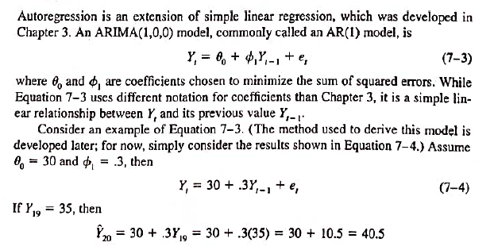
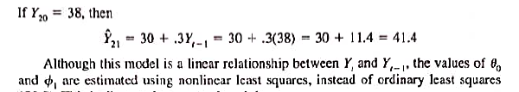
ARIMA Notation – p,d,q

Slide 19
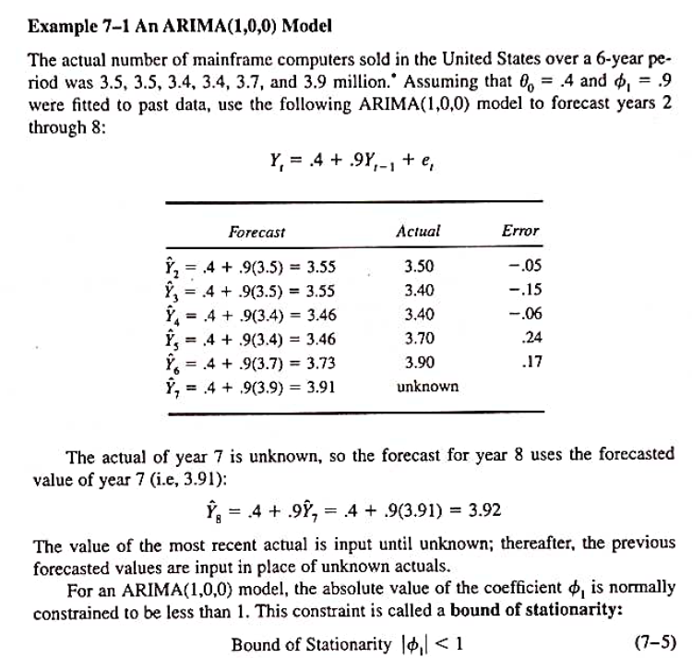

Slide 20
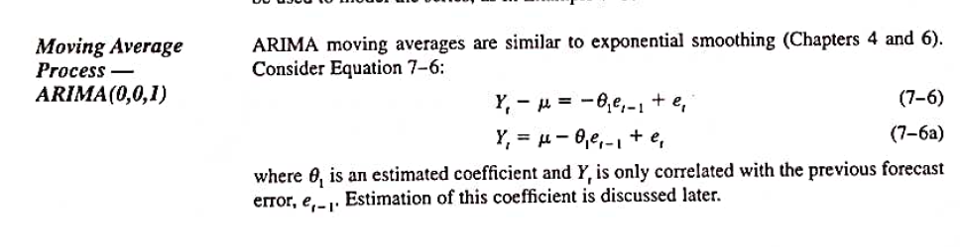
ARIMA (0,0,1)

Slide 21
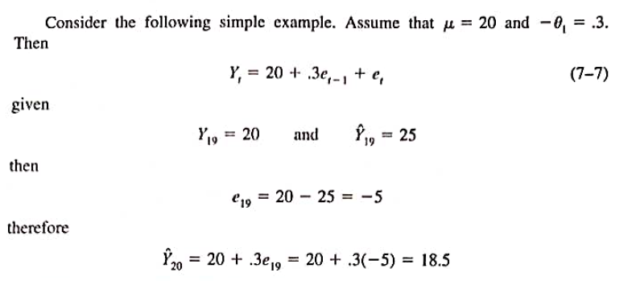
ARIMA (0,0,1)

Slide 22
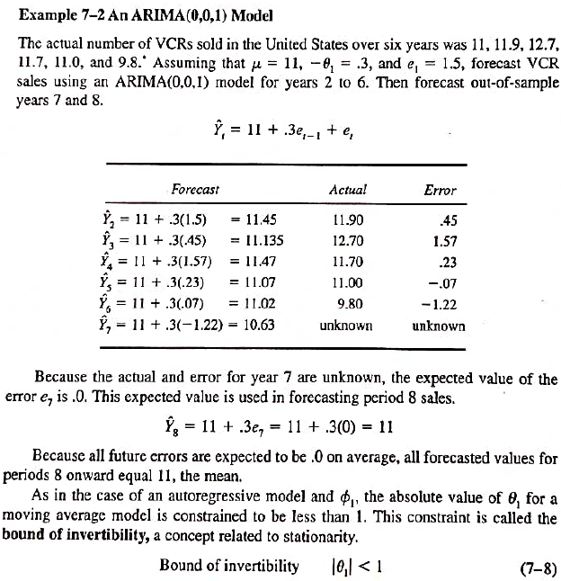

Slide 23
End Part1

